Slide 1
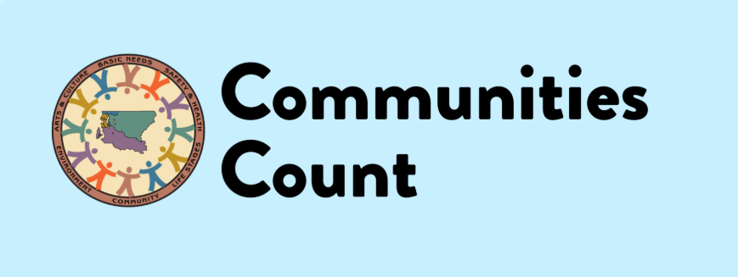
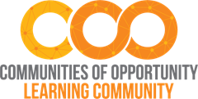
Racism as a Public Health Crisis: Data Storytelling
Sara Jaye Sanford, Mariko Toyoji, and Hani Mohamed
Communities of Opportunity, November 2021
Notes:
Communities Count is a resource that supports King County communities in the use of data to promote and achieve equity. Communities Count does this by: Providing data support and trainings to King County communities & Highlighting data on disparities, inequities and strengths in our community.
We are a public – private partnership, with staff based in Public Health – Seattle & King County.

Slide 2
Land Acknowledgement
We gather today on the ancestral land of the first people of Seattle, the Duwamish People.
We honor with gratitude the land itself and the Duwamish Tribe, and all of the Native people who call King County home.
Notes:
This acknowledgement is one small step against the erasure of our Native communities. In addition to the Duwamish, King County is home to the traditional lands of the Muckleshoot, Snoqualmie, and Tulalip tribes and other Coast Salish people. Today, King County is home to a vibrant and diverse community of indigenous people from across North America and beyond. Resources: https://www.duwamishtribe.org/land-acknowledgement https://www.realrentduwamish.org/land-acknowledgement.html

Slide 3
Acknowledgements
This workshop is supported by the Communities of Opportunity (COO) Learning Community.
COO is a public-private-community initiative, funded by King County through Best Starts for Kids and the Seattle Foundation, that works through community-driven partnerships to create greater racial, economic, and health equity so that all youth, families and communities in King County thrive and prosper. The COO Learning Community leverages the power of collective knowledge to accelerate change, focusing on providing resources for shared learning opportunities, building critical connections, supporting capacity building, and the creation of equity tools, models and conditions that actualize the thriving communities we envision.
Visit http://www.coopartnerships.org to learn more.

Slide 4
Agenda
Meeting norms, Intros, and goals
Introduction to Data Storytelling
Panel Discussion
Close-out/feedback

Slide 5
Purpose for today’s workshop
The purpose of this workshop is to introduce community-based partners to frameworks they can apply to data storytelling and share examples of how partners have gathered and shared data stories to support and advocate for the needs of the communities they serve. During this workshop you will hear from three community partners who will share their journey throughout the data storytelling process.
After this session, participants will have a better understanding of how storytelling can be used to present data, components of what makes a strong story and how equity is essential for data storytelling.
Notes:
Today we will be introducing some frameworks that can be used in data storytelling and will hear from our panelists on how they have gathered and shared data stories to support and advocate for community needs and about their journey through the data storytelling process.
Through this session we hope that you joining us today walk away with ideas on how storytelling can be used to present data, an understanding of the elements that make for strong stories and how equity is a key part of data storytelling

Slide 6
Meeting Norms
Kids, pets, and sweats are ok!
Take care of yourself: Snacks and drinks are welcome. Take a break if you need one.
We love to see your faces and welcome you to be on camera if you would like to, but feel free to stay off-camera if you are more comfortable that way.
We will be monitoring chat as well as pausing to invite spoken questions.
Respect the experiences and perspectives others share.
Optional: Introduce yourself in the chat, with your name and organization!

Slide 7
Learning goals & expectations
Learning goals
After this workshop attendees will…
Recognize that a variety of data sources (including numbers, stories, quotes, & images) can help create a compelling & comprehensive story about the communities and work that your agency supports to highlight impacts of systems, program, and/or policies
Learn how storytelling can be used to present data, components of what makes a strong story and how equity is essential for data storytelling
Hear how organizations have gathered and shared data stories to support and advocate for the needs of the communities they serve
Expectations for participation
We value the perspectives, expertise, and discussions of King County community-based organizations (CBOs) during this workshop. While individuals from other agencies and institutions may be attending, it is expected that individuals from these agencies will be invited to primarily “listen & learn” from the insights, questions, and discussion of our CBO partners

Slide 8
Data storytelling

Slide 9
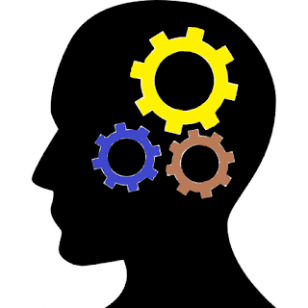
What makes a story?
Hand:
Take action!
Head: Think!
Heart: Feel!
Notes:
When you use your data to communicate with your audience – for example with staff, volunteers, donors, or potential funders, think about three elements.
This about this in putting your data story together. The “hand” might be your goal; “think” might be the data; the “heart” is how you emotionally connect to your audience.
Data storytelling combines a data point with stories, pictures, or other information to reach all three?
Many stories have a narrative arc – like a beginning, middle, and end – but this can be different in different cultures. So it is important to think about your audience and what you want to reflect.

Slide 10
Using data storytelling for impact
"Data tells you what's happening, and stories tell you why"
Data/information is presented in a more cohesive and compelling way
Storytelling enhances memory which makes it easier for people retain the data being shared
When data and narrative are combined, your story appeals to people with a wider range of learning styles and values
Data storytelling also can support decision-making processes
Notes:
Data/information is presented in a more cohesive and compelling way
Storytelling also enhances memory which makes it easier for people retain the data being shared. Studies show that data that is shared through storytelling have long lasting impacts- 22 times more effectively when they are part of a story as compared to when they are presented as isolated data points
When information is shared in the form of a story it also helps with better seeing differences between the data by making the data more digestible and this allows for better comprehension
Data storytelling also allows for faster decision-making processes which creates a more cohesive story

Slide 11
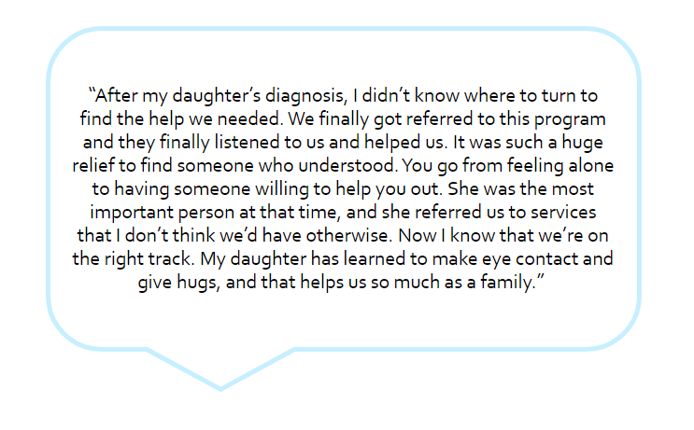
Storytelling using maps, images, and quotes
If you are working in a specific geographic area, a map can help you show that your area is demonstrating need or experiencing inequity.
Numbers and words are not the only way to share information. Images and pictures are also valuable data sources.
Stories directly from people are also data and this example (to the right) is based on a story that a parent shared about how a program helped them.
Notes:
If you are working in a specific geographic area, a map can help you show that your area is demonstrating or experiencing inequity. You could also get creative and share maps that show where your services are, or asset maps you may have made.
Numbers and words are not the only way to share information. Some say that a picture is worth a thousand words! If you have an image that powerfully shows the impact of your work or an issue you are engaged in you can use that as a part of your story.
Stories directly from people are also data….
This example is based on a story that a parent shared about how a program helped them. You can probably tell that I took out a lot of the specific details about the family and the program here – and you can imagine a story related to your work that would be even more impactful with those details!
Note: If you are using a participant words, you should do so with their permission, and again, WITHOUT any identifying information.
Storytelling through data and equity: data is used for policy making, grant writing, designing health program and so much more. Data should be used to advance equity and overall well being. Data can be used as a tool to perpetuate inequities but this is and can be preventable.

Slide 12
Storytelling for equity From Best Starts for Kids
Personalize
Avoid short, anonymous, over-simplified stories that remove the human element
Ask someone how they want their story shared
Ask community members to be partners in how and where stories are told. Ensure that telling a story that benefits an organization also benefits the individual. Be aware of the power dynamic and ask: would I share this story if it were about me?
Be a partner, not a savior
Represent your organization as a partner in a person or community's success, not their savior. Acknowledge individual's role in advocating for themselves and working hard to help themselves.
Ensure others can see themselves in the story
Stereotypes can be broken down when people see a family or friend's experience reflected in a story. Normalize the experience.
Challenge myths
Offer a surprising perspective, or new angle for an old issue to challenge myths and mental models.
Notes:
Because stories are powerful, we need to be mindful of how we use that power! And the importance of equity in storytelling, and how a story and the way in which it is told impacts individuals and the community.
NOTE: storytelling can also be used as a tool for creating antiracist spaces, systems, policies, etc.
These are some of the values Best Starts for Kids strives for to use our storytelling power for equity. You can find more on this in the Best Starts Blog’s resources section.
What are other ways we can work to ensure that our stories promote equity? What are ways you have been able to embed equity values in storytelling?

Slide 13
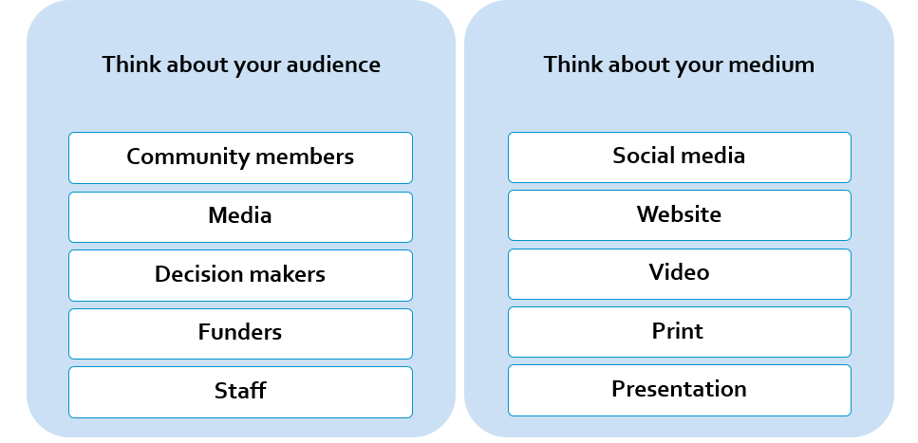
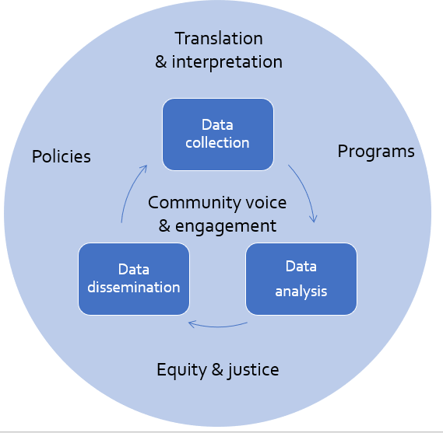
A few more tips related to data storytelling & dissemination
When thinking about your audience and medium, it is important to center the community/who the story is about throughout this process along with an opportunity for that community to help develop what story or message they want to convey.
Depending on the audience, it is also important to ensure that translated materials are linguistically and culturally appropriate.
Equity should be incorporated in funding, motivation, project design, data collection & sourcing, analysis, interpretation, and communication & distribution
Notes:
A few more tips before we dive into practicing! Consider your audience for a story and the best way to reach them
Yes, there are many more potential audiences and mediums, as well as overlap between these categories!
A note on media: There are unique strategies for communicating well with media! If you anticipate doing a lot of media work, consider finding some media training! It really helps to prepare: memorize the key points that are most important to you to share; prep answers for the most likely and toughest questions. Research the reporter and outlet. Stay on message, honest, and direct. https://www.thenationalcouncil.org/wp-content/uploads/2016/11/Tips-for-Talking-with-Reporters.pdf
If your audience is decision makers: Keep it SHORT and clear! If you’re creating a handout – think one side of one page with lots of white space and a clear connection to the policy of interest. They don’t have time to read more.
Note, other audiences may also prefer briefer stories! Everyone is busy and attention is hard to keep.
We could explore more in depth about reaching different audiences and using different mediums in future workshops if you are interested. For now, the most important thing to know is that you need to know who your audience is and keep their needs in mind as you develop your story.

Slide 14
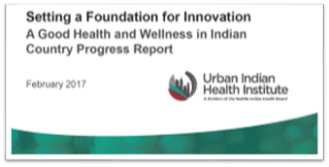
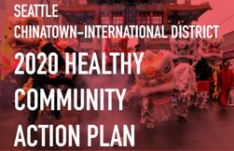
GETTING CREATIVE… What other sources are out there?
Notes:
While we are making lots of data available, you might not find information specific to the cultural, racial/ethnic, or geographic community you serve, or the issue you’re trying to address.
Here are some ideas to get you started:
Is there a national organization dedicated to your community or issue? They may have helpful data. (For example, the Urban Indian Health Institute publishes reports about the health and wellbeing of AI/AN people in major cities. We don’t have a lot of data on trans students, but national organization do, such as The National Center for Transgender Equality.
Is there a local community organization that may share information specific to the community? (Two examples are the Interim CCDA’s community health action and the White Center Community Development Association.)
TEEC and Snoqualmie Valley Supportive Community for all are examples of COO partners that have collected their own data!
What are other data sources that you have found helpful? [Solicit participant input.]

Slide 15
Questions for Panel
Please take a moment and tell us about your project
Did you set out with a specific question you wanted to answer?
What methods did you choose and why?
How did you center equity throughout your process?
How are you sharing your findings with different audiences?
What kind of actions do you hope people will take based on your findings?

Slide 16
Question for Panel
What are important things you consider when doing data collection and storytelling?
How do you take the data and stories captured in interviews and groups and build a story that can influence change?
How have you used data storytelling for policy and systems change?
What lessons learned would you like to share?

Slide 17
We would love your feedback!
Please take a few moments to complete this survey: https://www.surveymonkey.com/r/X868HT9

Slide 18
Keep in Touch!
Thank you!
Visit us at: communitiescount.org
Contact us: communitiescount@kingcounty.gov
Sara Jaye Sanford: sjsanford@kingcounty.gov
Hani Mohamed: hanimohamed@kingcounty.gov
Joie McCracken: jmccracken@kingcounty.gov
Mariko Toyoji: mtoyoji@kingcounty.gov

